Slide 1
Logistic Regression

Slide 2
Typical Data Science Cycle
Data Collection
Business Insights & Understanding
Data Understanding
Model Building & Evaluation
Data Pre-Processing

Slide 3
Machine Learning
Supervised ML
(Target Variables)
Classification
Regression
Linear Regression (Causal) , Time Series
Logistic Regression , Decision Tree

Slide 4
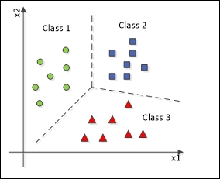
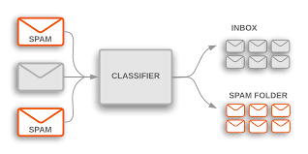
Classification Modelling
Classification is a technique where we categorize data into a given number of classes.
Classification is a task that requires the use of machine learning algorithms that learn how to assign a class label to examples from the problem domain.
An easy to understand example is classifying emails as “spam” or “not spam.”

Slide 5
Logistic Regression
A manufacturing company manager wants to improve efficiency of plant. He believes that if we proactively identify machine failure, we can provide maintenance in advance and therefore we can avoid down-time.
He collected plant machine performance data for last 2 year and develops a logistic regression model to predict whether we can predict failure of machine or not. Now, on a certain day he tests his model on a random machine.
Based on some attributes of 2 machines (such as machine temperature, pressure, voltage, noise) he predicts that :
For first machine there is a 0.7 probability of getting failure.
For Second machine there is a 0.65 probability of getting failure.

Slide 6
Logistic Regression
Also Called Logit Model. It is based upon linear equation of independent variables but later converted into non-linear
Y = a+bx
Output is first provided in probability then assigned into category
Two Main Objectives
1. Establish if there is a statistically significant relationship between two variables. (Classification and Prescription)
2. Mostly used for Binary classification (Target variable is binary/categorical). (Classification)
e.g. Whether the person will default on loan (Yes/No)
e.g. Whether team india will win (Yes/No)
e.g. Whether this email is spam (Yes/No)
e.g. Whether person will click on my campaign (Yes/No)

Slide 7
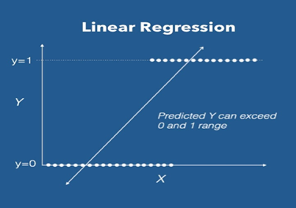
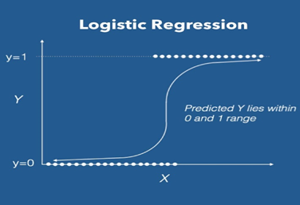
Logistic Regression
Limitation of Linear Regression Model
Logistic regression requires output in form of probability (from 0 to 1)
Existing linear regression model has a range of –infinity to +infinity (y = a + bx)
So we can not use probability as a target variable in linear regression
p (target variable) = a + bx
We apply linear model through some transformation using logit function so that
our target variable (probability) can be bounded between 0 and 1

Slide 8



Logistic Regression
Solution of Limitation in using Linear Model
Defining Odds
Odds = $\frac{P}{1−P}$
Ratio of (Probability of success and Probability of failure) is called odds of success
We solve our half of challenge by using odds in linear equation instead of probability.
While p goes from 0 to 1 ,
Odds ($\frac{P}{1−P})$ goes from 0 to infinity.
$$\frac{P}{1−P} =a+bx$$
We solve other half of problem by taking natural log of odds
While $odds (\frac{P}{1−P})$ goes from 0 to infinity , log(odds) goes from -infinity to infinity.
$$\log\left(\frac{P}{1−P}\right)=a+bx$$

Slide 9
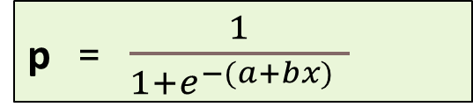
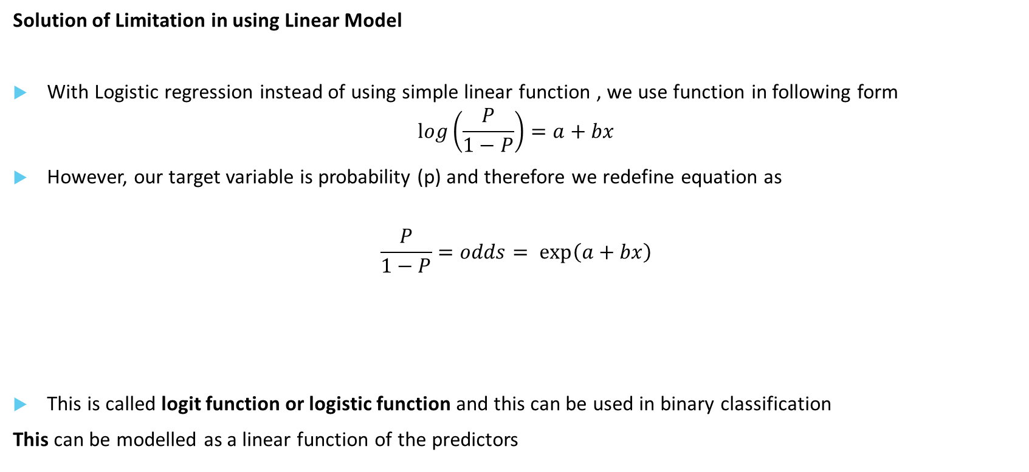
Logistic Regression
Solution of Limitation in using Linear Model
With Logistic regression instead of using simple linear function , we use function in following form
$$\log\left(\frac{P}{1−P}\right)=a+bx$$
However, our target variable is probability (p) and therefore we redefine equation as
$$\frac{P}{1−P}=odds= \exp\left(a+bx\right)$$
This is called logit function or logistic function and this can be used in binary classification
This can be modelled as a linear function of the predictors
p = $\frac{1}{1+ⅇ^{−(a+bx) }}$

Slide 10
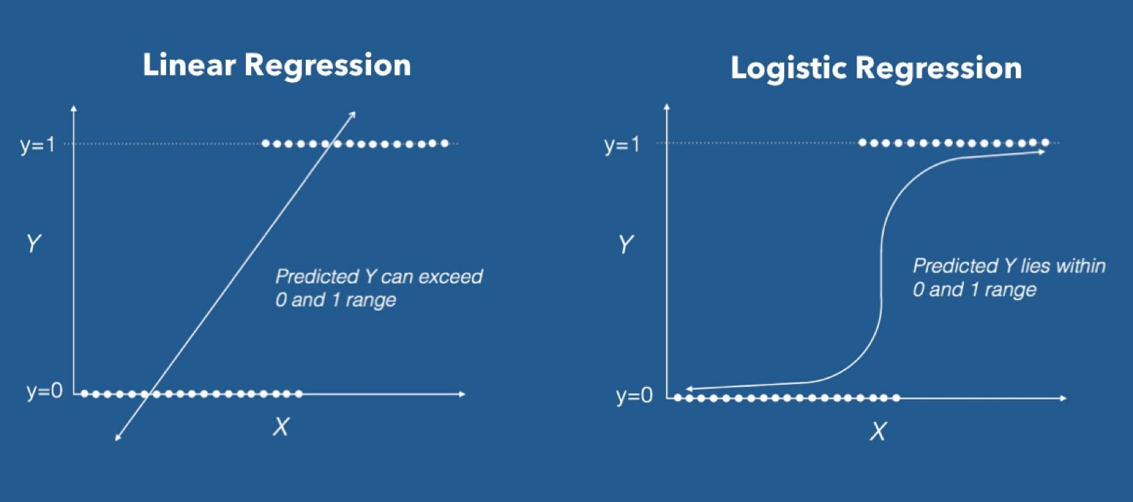
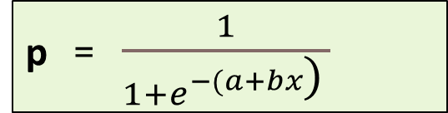
Logistic Regression
p = $\frac{1}{1+ⅇ^{−(a+bx\text{)} }}$
This type of function is called sigmoid function.
Sigmoid functions most often show a return value (y axis) in the range 0 to 1
This curve
Is sometimes referred
As S-curve

Slide 11

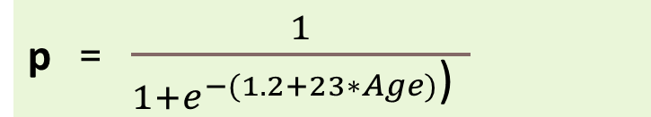
Logistic Regression
Threshold level cut off
Default Model produces an estimated probability of being a “1”
Hence we can define a threshold level to assign a label to outcome.
e.g. For a bank loan default problem
Target variable is default . 1 = default , 0 = non-default
p = $\frac{1}{1+ⅇ^{−(a+bx) }}$
P=0.7
p = $\frac{1}{1+ⅇ^{−(1.2+23∗Age)\text{)} }}$
P (y = ‘Default’/Age = 46) = 0.7
if logit function gives p= 0.7, we can say that if I keep threshold at 0.5 for risk management,
This person will be put under loan default category.

Slide 12
Logistic Regression
Ways to Determine Cutoff
0.50 is popular initial choice
Additional considerations
1. Maximize classification accuracy
2. Maximize sensitivity (subject to min. level of
specificity)
3. Minimize false positives (subject to max. false
negative rate)
4. Minimize expected cost of misclassification
(need to specify costs)

Slide 13

Logistic Regression
Significance of coefficients in logistic regression equation
1. These estimates tell you about the relationship between the independent variables and the dependent variable, where the dependent variable is on the logit scale.
2. We can directly see effect on log(odd). We can not interpret direct increase in probability by simply using linear equation.
3. These estimates tell the amount of increase in the predicted log odds of target variable (class = 1) that would be predicted by a 1 unit increase in the predictor, holding all other predictors constant.
$$\log\left(\frac{P}{1−P}\right)=a+bx$$

Slide 14
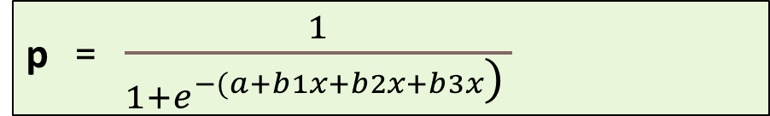
Multiple Logistic Regression
multiple logistic regression analysis applies when there is a single target variable and more than one independent variable
p = $\frac{1}{1+ⅇ^{−(a+b1x+b2x+b3x\text{)} }}$
e.g. what is the probability that a customer will buy my product given certain attribute
p = $\frac{1}{1+ⅇ^{−(\text{100 }\text{−}\text{ 10∗(}\text{Distance} \text{k}\text{.}\text{m}\text{. }\text{of} \text{warehouse}\text{) – 132.3∗(}\text{Product} \text{Price} \text{in} \text{Rs}\text{)} \text{)} }}$

Slide 15
Multiple Logistic Regression
New Considerations : Adding more independent variables doesn’t mean that the logistic regression will be better; in fact it can make things worse.
Overfitting
When fitting models, it is possible to increase the likelihood by adding parameters, but doing so may result in overfitting. Model will be too complex that it will fail to generalize well on test data (unseen data).
Multicollinearity
The addition of more independent variables creates more relationship among them.
Not only are the independent variables correlated to the dependent variable,
they are also potentially correlated to each other.

Slide 16
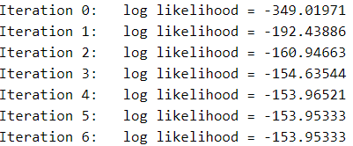
Logistic Regression
In linear regression we used to optimize the cost function by minimizing the sum of
Squares of residuals (Method is called Ordinary Least Square) . Through this method
We obtained best line of fit (y = a+bx) and its parameters.
In Logistic regression ,best parameters are estimated by an iterative process called Maximum Likelihood Estimation (MLE).
This method tries to maximize likelihood function (a function that is
used to measure Goodness of fit of a statistical model to a sample data
for given values of parameters) following Multiple iterations using
different parameter estimates. This procedure is done by taking logarithm of likelihood.

Slide 17

Logistic Regression : Assumptions
Although Logistic regression is treated as linear classifier, still it does not follow many assumptions
Of linear regression (mostly which are dependent on errors). Such as :
1. It does not require linear relationship between dependent and independent variables. Though
Log(odds) needs to be linearly related
2. The error terms do not need to be normally distributed.
3. Homoscedasticity is not required.
$$\log\left(\frac{P}{1−P}\right)=a+bx$$

Slide 18
Logistic Regression : Assumptions
The logistic regression usually requires a large sample size to predict properly. (Large ratio of variables to observations i.e. column to rows might lead to non-convergence which means you might not achieve best parameters (a,b) using iterative process MLE and that leads to failure of development of logit model)
The logistic regression assumes that there is minimal or no multi-collinearity among the independent variables. (may cause non-convergence)
The Logistic regression which has two classes assumes that the dependent variable is binary .
Also P(Y=1) is the probability of the event occurring, it is necessary that the dependent variable is coded accordingly. That is, for a binary regression, the factor level 1 of the dependent variable should represent the desired outcome.
The Logistic regression assumes the observations to be independent of each other.

Slide 19
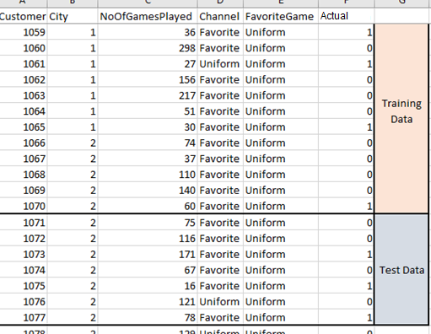
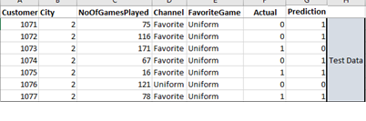
Classification Modelling
Performance validation of Classification Modelling
Modelling on Training Data
ML Model
Apply on Test Data
Prediction

Slide 20
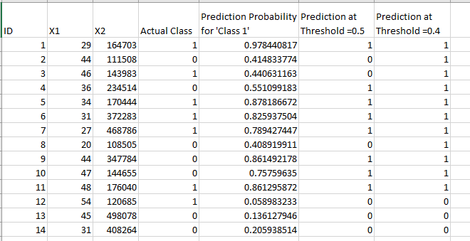
Logistic Regression
Threshold level cut off : Example

Slide 21
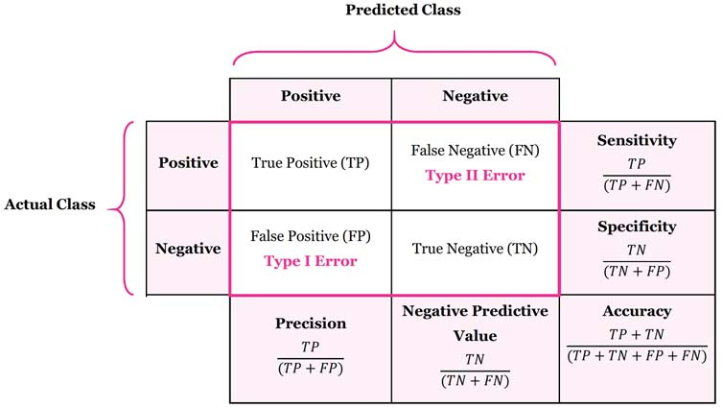
Metrics
Confusion Matrix
Accuracy Total correct predictions out of total observation
Sensitivity/True Positive rate/Recall measures the proportion of positives that are correctly identified. the proportion of those who are spam and correctly identified as “Spam”.
Specificity/True Negative rate measures the proportion of negative that are correctly identified. the proportion of those emails who are non spam and correctly identified as “Non -Spam.”

Slide 22
Metrics
AIC: Given a collection of models for the data, AIC estimates the quality of each model, relative to each of the other models. Thus, AIC provides a means for model selection. It signifies the amount of information loss in model.
BIC: BIC is also a criterion for model selection among a finite set of models; the model with the lowest BIC is preferred
Both BIC and AIC attempt to introduce a penalty term for the number of parameters in the model; the penalty term is larger in BIC than in AIC. Thus they help to avoid overfitting.
ROC – Receiver Operating Characteristics : Shows the plot between True positive rate and False positive at different threshold value
AUC – Area Under the ROC Curve
AUC – Measures discrimination, i.e., ability to correctly classify those SPAM and NON-SPAM.
AUC is the percentage of randomly drawn such pairs for which the classification is done correctly.

Slide 23
Metrics
Example of Spam Vs Non-Spam Model (Total Observation in dataset: 922 + 170 = 1092)
Actual Counts
Non-Spam: 922
SPAM: 170
Sensitivity
Specificity
Probability Threshold for Discriminating Between SPAM and Non-Spam | True Positives | False Positives | True Negatives | False Negatives
0.9 | 0 | 0 | 922 | 170
0.7 | 1 | 1 | 921 | 169
0.5 | 12 | 7 | 915 | 158
0.3 | 46 | 76 | 846 | 124
0.1 | 140 | 468 | 454 | 30
ROC Curve

Slide 24
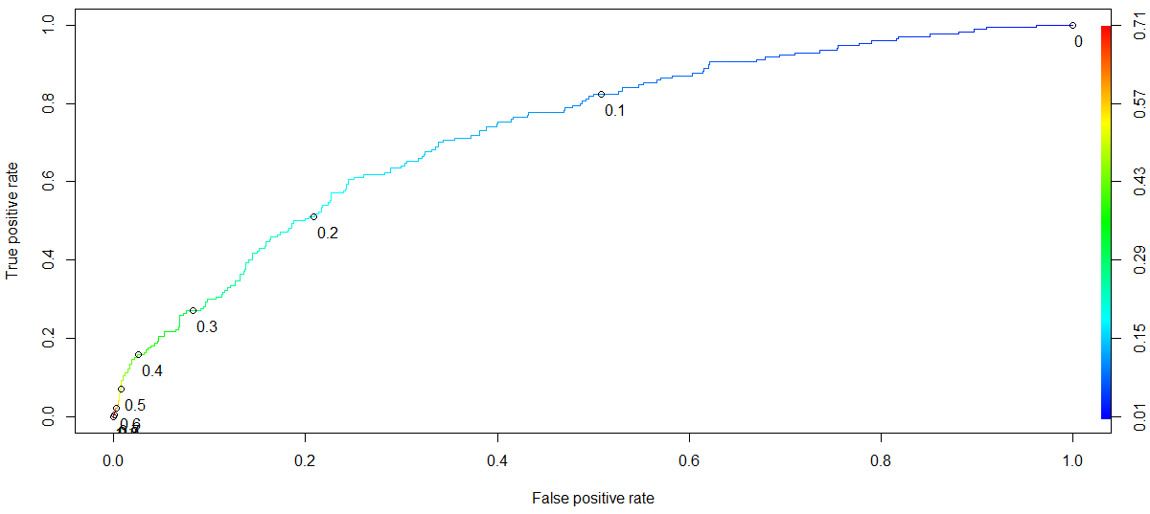
Metrics
Example of Spam Vs Non-Spam Model

Slide 25
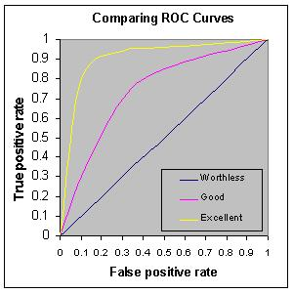
Metrics
Rough rule of thumb:
0.90 -1.0 = Excellent
0.80 – 0.90 = Good
0.70 – 0.80 = Fair
0.60 – 0.70 = Poor
0.50 – 0.60 = Fail
<0.50 – You are better off doing a coin toss than working hard to build a model ☺

Slide 26
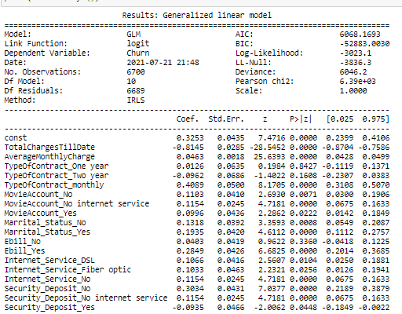
Logistic Regression
1 .Equation:
Log(odds) = 0.3252 - 0.8145*TotalchargesTillDate …. -0.0935*Security_Deposit_Yes
2. Compare two models using
AIC (Akaike information criterion)
BIC (Bayesian information criterion)
Lesser the better
3. Identify significant variables that impact log(odd) using p value
4. Variables with (-) coefficients tells us they have negative
Impact on churn of customers.

